Slide 1
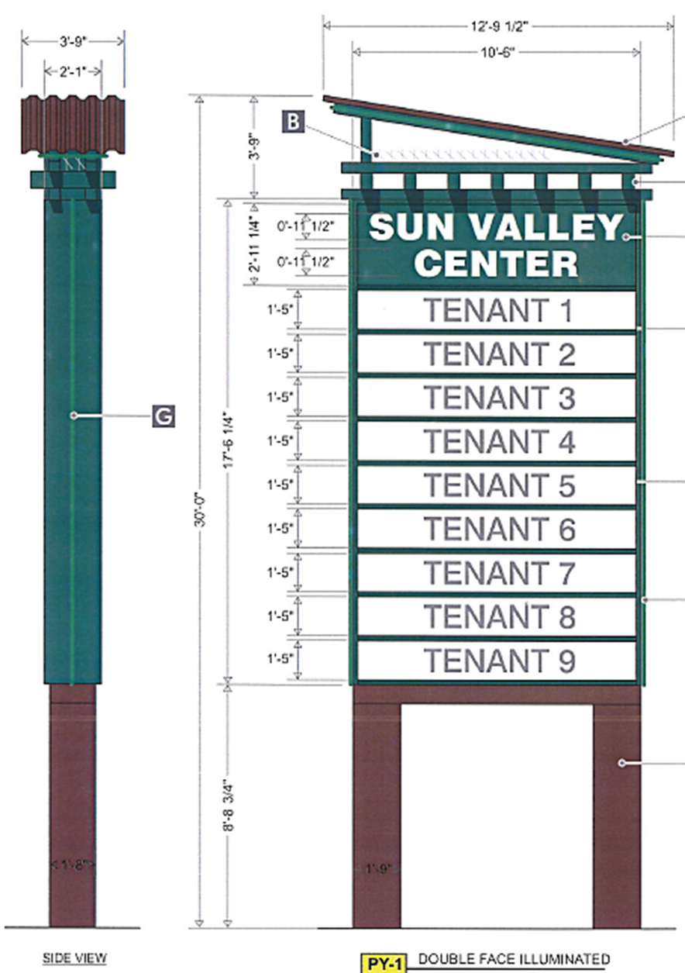
WADMIN17-0011 Sun Valley Center Pylon Sign
Washoe County
Board of Adjustment
February 1, 2018

Slide 2
Overview
Applicant: YESCO, LLC
Property Owner: Sun Valley Center, LLC
Location: 5055 Sun Valley Boulevard

Slide 3
Overview
For possible action, hearing, and discussion to approve the construction of a pylon sign, 30 feet in height and 183 square feet in size. The sign is proposed to be approximately 13 feet in width. A pylon sign is a free standing sign that advertises multiple businesses on one site.
Table 110.505.1,
“Commercial and Retail” freestanding signs are limited to 20 feet in height and 120 square feet
With approval of an Administrative Permit, 30 feet in height and up to 200 square feet in size may be permitted

Slide 4
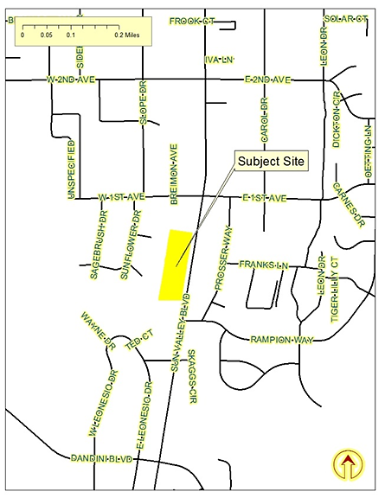
Vicinity Map

Slide 5
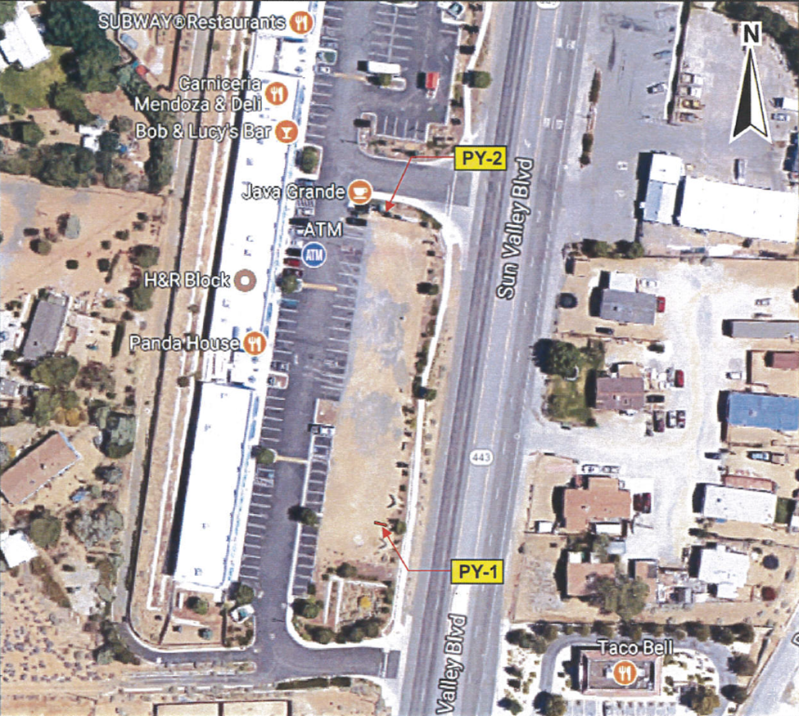
Site Plan

Slide 6
Evaluation
Proposed height and size of the sign are in compliance with Code
Proposed location is in compliance with Code
Will not create a hazard to traffic
Is not within 75 feet of another permitted freestanding sign
Is not in a special flood hazard area

Slide 7
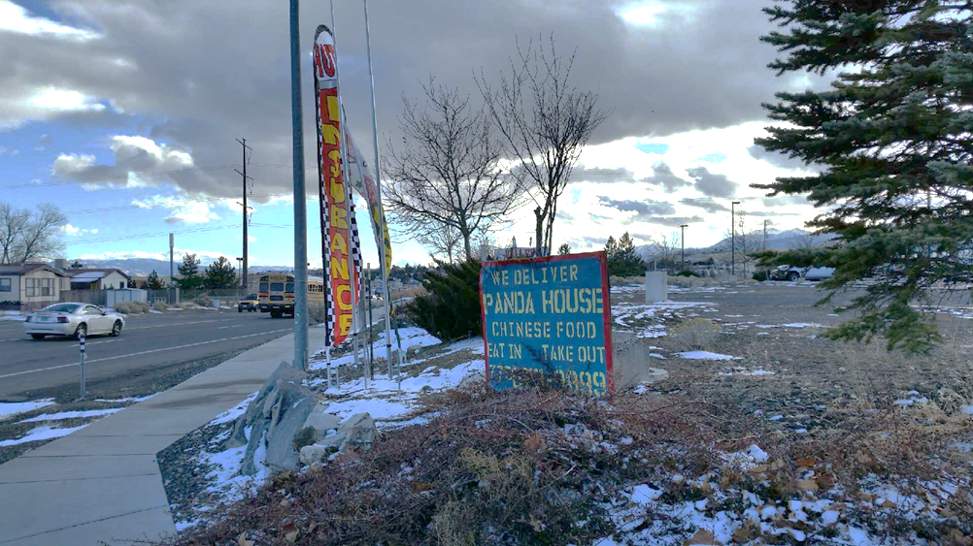
Evaluation
Many freestanding signs have been erected on the subject site without permits.
Conditions of approval have been included to require removal prior to issuance of a building permit for the new pylon sign.

Slide 8
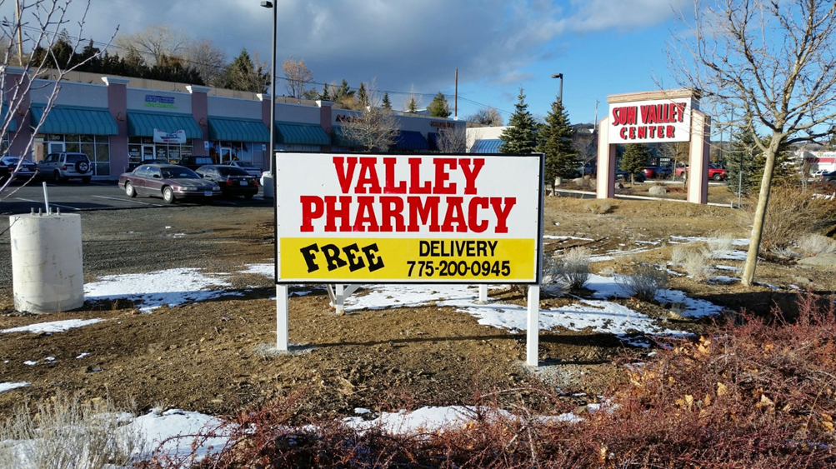
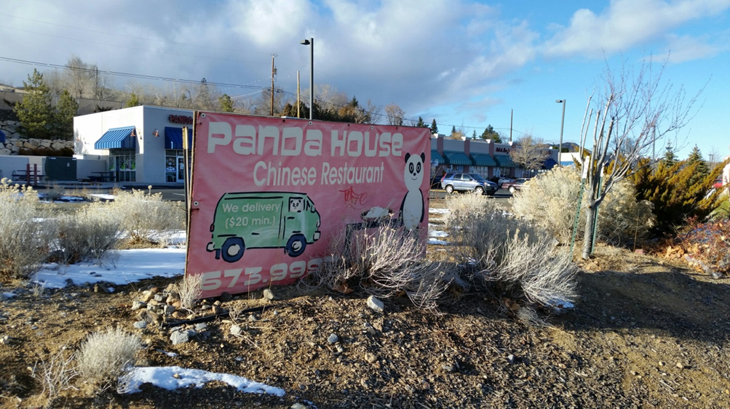
Evaluation

Slide 9
Evaluation
Several businesses within the Sun Valley Center have building-mounted signage that is not in compliance with Code.
Window signs may cover a maximum of 25% of any window.
Conditions of approval have been included to require compliance prior to issuance of a building permit for the new pylon sign.

Slide 10
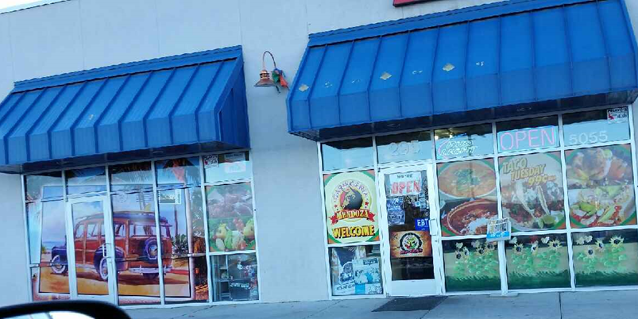
Evaluation

Slide 11
Evaluation
size, style and location of the proposed sign are in keeping with the character of the surrounding area
compliance with several provisions of the Code must be pursued by the applicant
it is the opinion of staff that a recommendation of approval, subject to conditions, is appropriate

Slide 12
Sun Valley CAB
No meeting was held during the review time for this project
Project application was provided to all members of the CAB
Individual comments were requested
No comments received

Slide 13
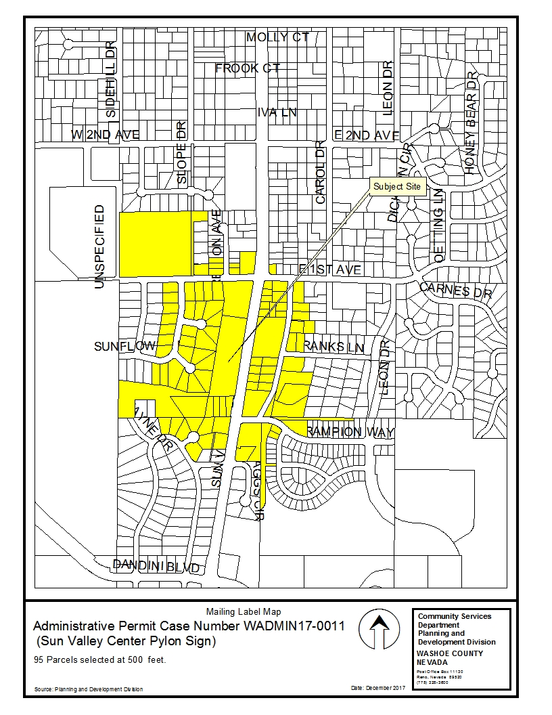
Public Notice 77 individual property owners

Slide 14
Reviewing Agencies
Washoe County Community Service
Planning and Building Division
Engineering and Capital Projects
Washoe County Health District
Environmental Health Services
Regional Transportation District
Truckee Meadows Fire Protection District
Washoe / Storey Conservation District
Washoe County Sheriff

Slide 15
Reviewing Agencies
No recommendation for denial
Only Planning provided conditions of approval

Slide 16
Administrative Permit Findings

Slide 17
Administrative Permit Findings

Slide 18
Administrative Permit Findings

Slide 19
Recommendation
Those agencies which reviewed the application recommended conditions in support of approval of the project. Therefore, after a thorough analysis and review, Administrative Permit Case Number WADMIN17-0011 is being recommended for approval with conditions.

Slide 20
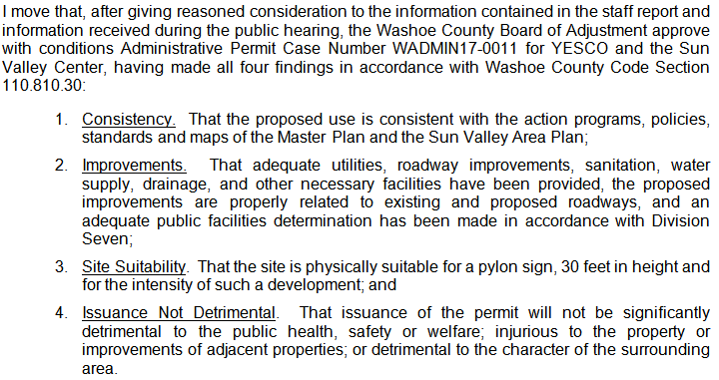
Possible Motion
110.808.25:

Slide 21
Questions?

